Slide 1

SUICIDE GLOBAL RATES OVERVIEW 1985 TO 2015
Nirmal Joy
February 11th 2022

Slide 2
Problem:
Solution:
Why do people commit to suicide
Identify is there any demographic and economic factors affects the suicide rate

Slide 3
Analytical goals
WHY: Quantity impact on suicide rate
HOW: Identify what people wants to know about
WHAT: What will be the changes in the suicide rate
in future

Slide 4
Analytical goals
WHY: Quantity impact on suicide rate
HOW: Identify what people wants to know about
WHAT: Identify what would be the change in the suicide rate in future

Slide 5
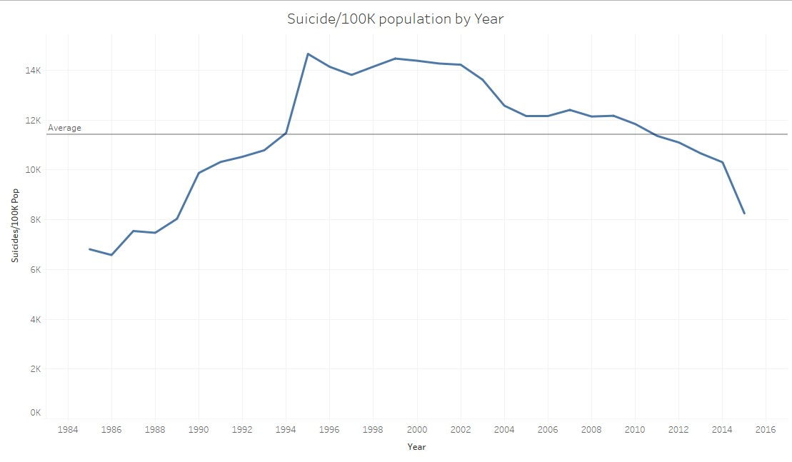

Slide 6
Downward Trend
Suicide/100k pop have been falling since 1999.
Since 2010 ,Suicide/100k pop rate is below than average rate
Highest Suicide/100K pop was on 1995
Source: Suicide/1000K pop from 1985-2015

Slide 7
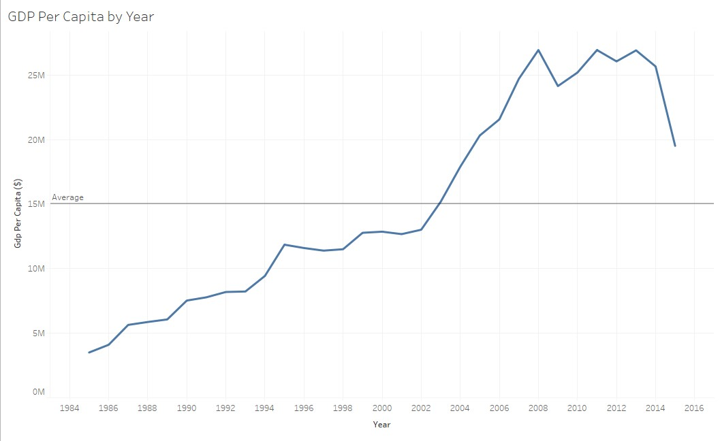

Slide 8
The Reason
Upward Trend
Gross domestic Production(GDP) per capita have been a uprising since 1995
Since 2004 , The gross domestic Production(GDP) per capita rate have been higher than average of GDP
Growth of GDP is highly impact on the suicide rate
Source: GDP per capita from 1985-2015

Slide 9
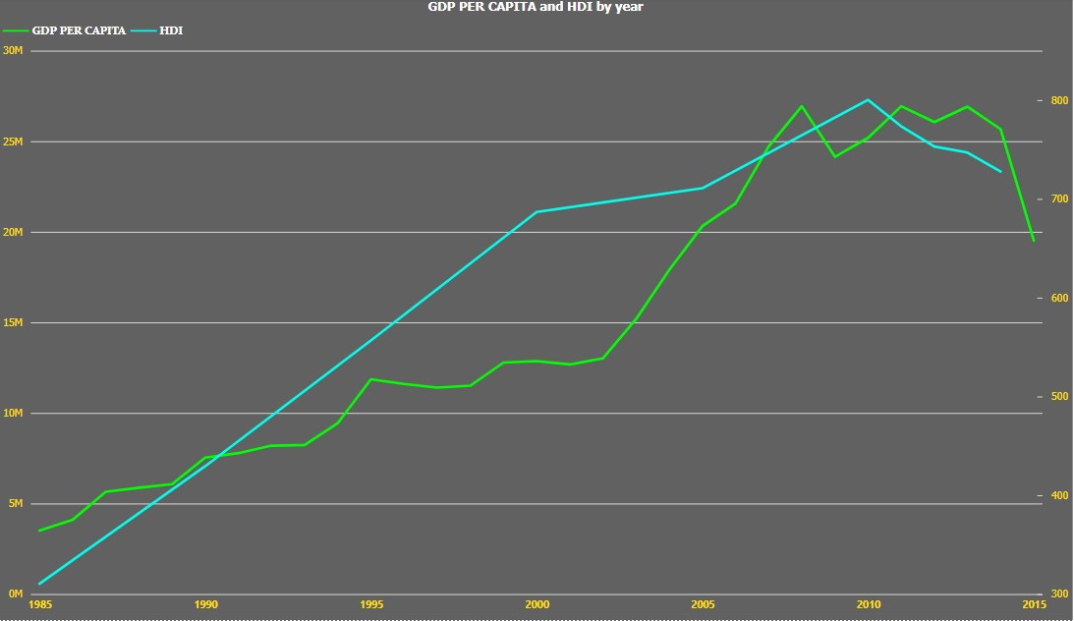
HDI and GDP
Human Development Index(HDI) also have the vital role for the reduction of suicide rate
GDP is proportional to HDI , thus HDI is another factor influencing the suicide rate

Slide 10
Thus, Nation need to increase the Economic growth(GDP) to reduce the human suicide rate and improve the Human development Index

Slide 11
Analytical goals
WHY: Quantity impact on suicide rate
HOW: Identify what people wants to know about
WHAT: Identify what will be the changes in the suicide rate in future

Slide 12
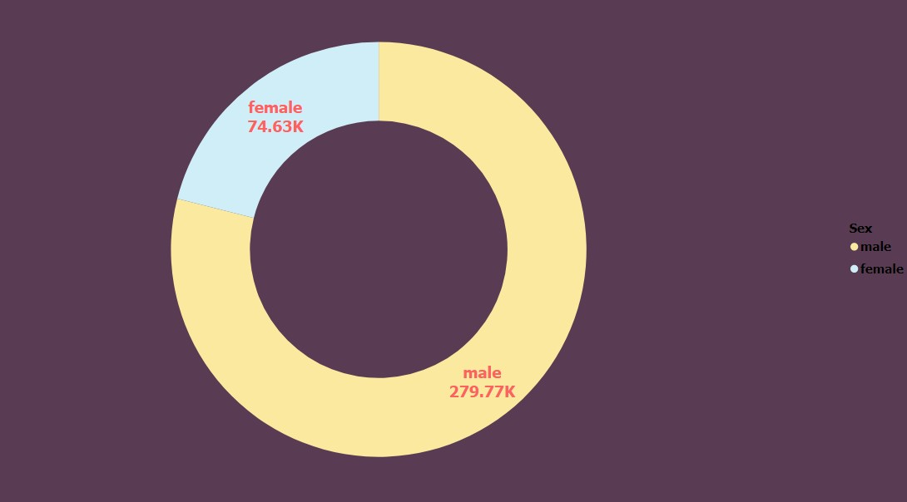
Gender
Total number of suicide commits can be grouped by gender
as
Male and Female
Most number of commit suicide done by male 279.77K
Count of suicide by male is 3 times greater than count of female

Slide 13
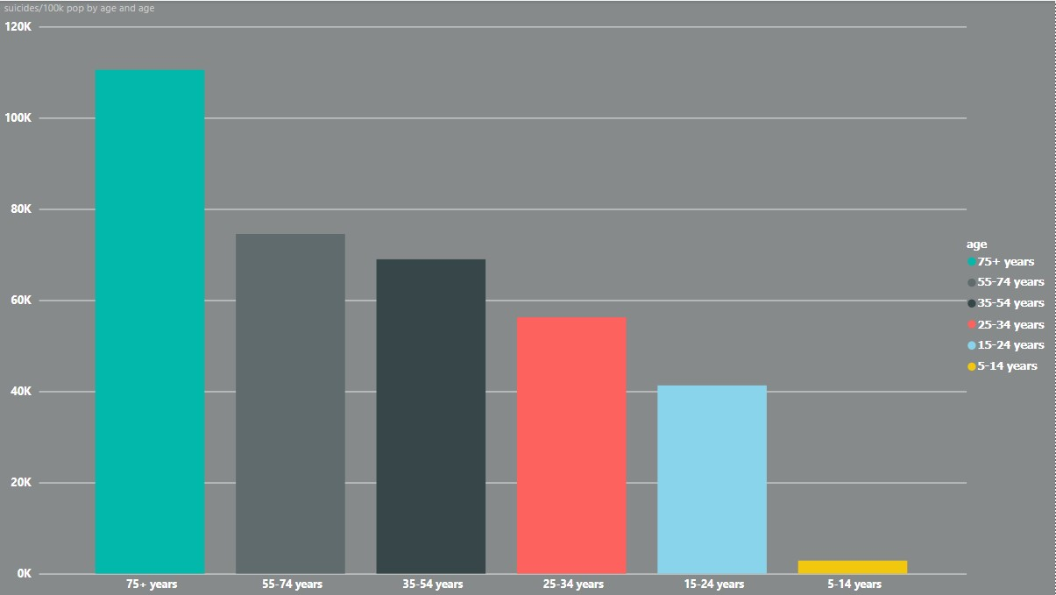
Prioritize 75+ years
Currently, 75+ years category are the most number of suicides commits.
This category faces more economic and mental challenges
75+ category have been less economic power and they don’t have purchase power.
An aging population and slower labor force growth affect economies
Then growth of GDP will falls down

Slide 14
Lack of financial stability , older adults will experience a mental health problem such as depression or anxiety, and the physical and cognitive changes some people experience as they age can make these issues even more challenging. In addition, as some people age, their risk of suicide increases
Thus, working-age people should pay more to support the elderly category

Slide 15
Analytical goals
WHY: Quantity impact on suicide rate
HOW: Identify the factors that influence the suicide rate
WHAT: Identify what would be the change in the suicide rate in future

Slide 16
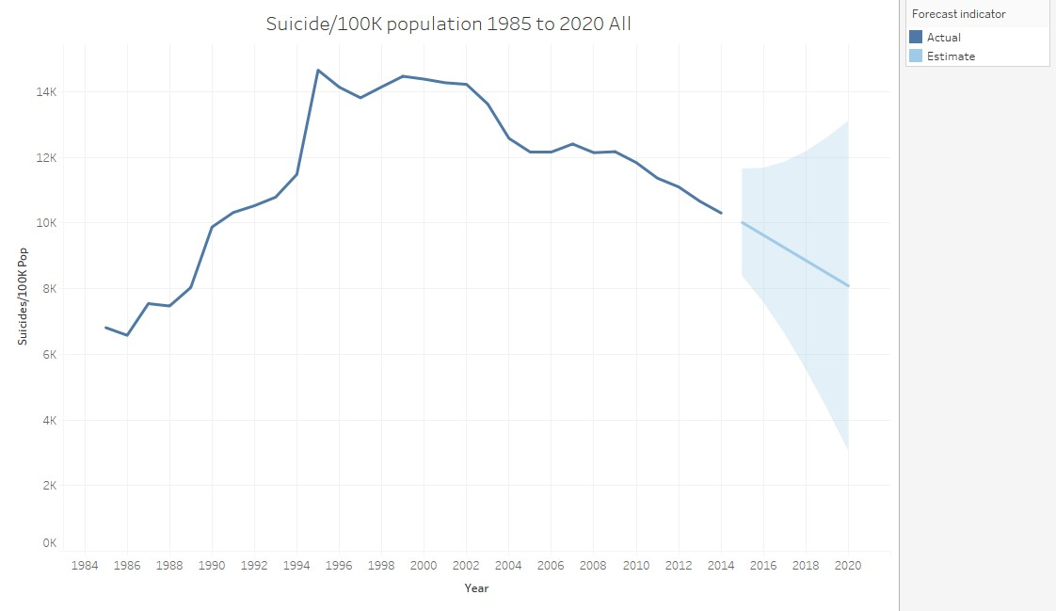

Slide 17
SUICIDE/100K pop by YEAR FORECAST
Great depression in trend
Forcast graph shows depression in Suicide/100k population

Slide 18
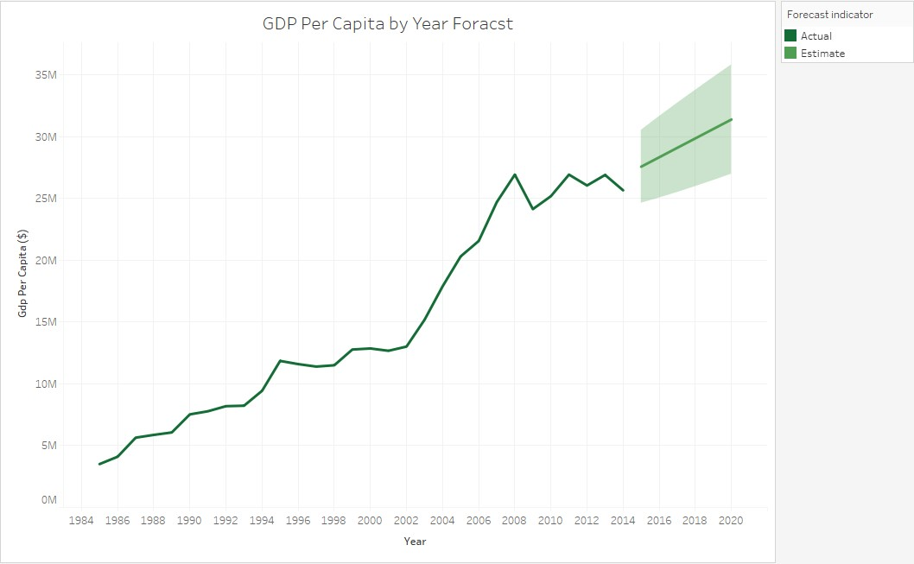
Great increase trend
Forcast graph shows Upward trend in Suicide/100k population

Slide 19
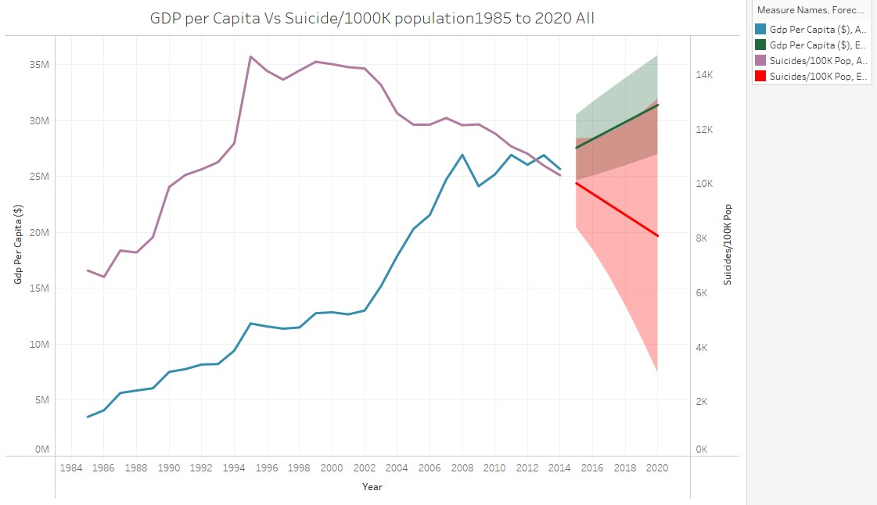

Slide 20
GDP vs SUICIDE FORECAST GRAPH
Graph shows , In future there will be a huge reduction in rate of suicide and National economy will higher
Economy of nation and Suicide rate is inversely proportional to each other
Forecast graph shows ,2020 will be the highest GDP all over the time

Slide 21
Thank You.

